Slide 1
AIPI 561 Operationalizing Large Language Models (LLMOPS)
Week 0 Demo Video
Chad Miller

Slide 2
Project Ideas
Protocol Abdominal CT scans using fine-tuned LLM
Chatbot for Duke Radiology departmental policies, user manuals for our image viewer and dictation software, and ultrasound physics resources
Translating Radiology reports into layperson language (5th grade level)
Error checking dictated reports

Slide 3
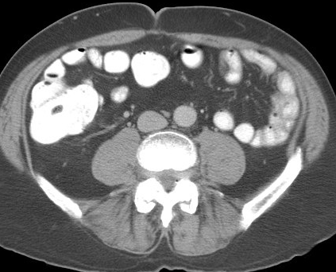
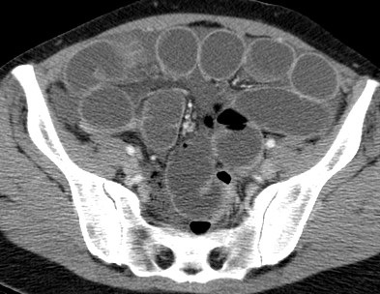
Protocol Abdominal CT scans using fine-tuned LLM
Positive Oral Contrast
Tailoring CT scan to the indication based on provided clinical information (clinic notes, order information, allergies, renal function)
Oral contrast? IV contrast?
Pre and post IV contrast images?
Timing or “phase” of imaging – arterial, portal venous, delays?
Special circumstances – rectal contrast? CT cystogram?
Contraindications to IV contrast
(renal insufficiency = cr>2.0 mg/dL, severe allergy)
Neutral Oral Contrast

Slide 4
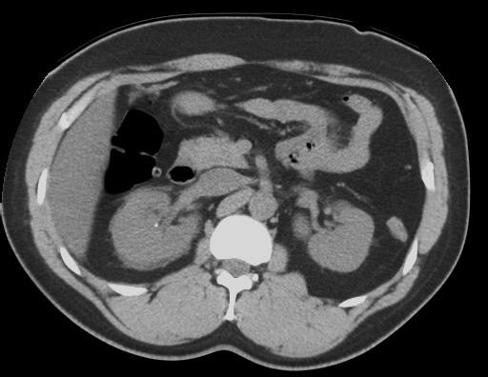
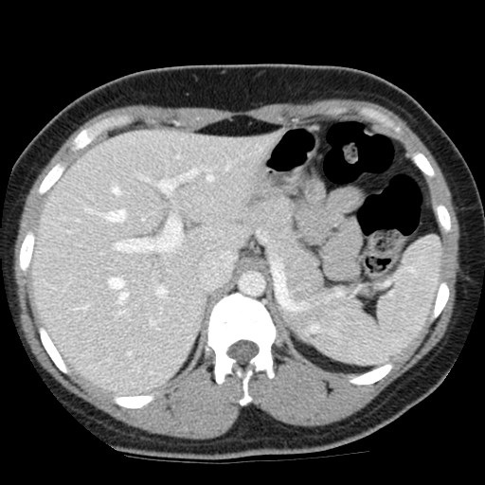
Protocol Abdominal CT scans using fine-tuned LLM
Tailoring CT scan to the indication based on provided clinical information (clinic notes, order information, allergies, renal function)
Without IV Contrast
Oral contrast? IV contrast?
Pre and post IV contrast images?
Timing or “phase” of imaging – arterial, portal venous, delays?
Special circumstances – rectal contrast? CT cystogram?
Contraindications to IV contrast
(renal insufficiency = cr>2.0 mg/dL, severe allergy)
With IV Contrast

Slide 5
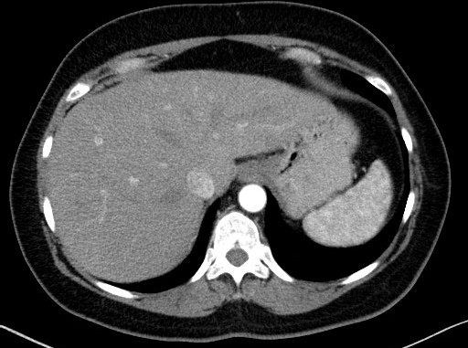
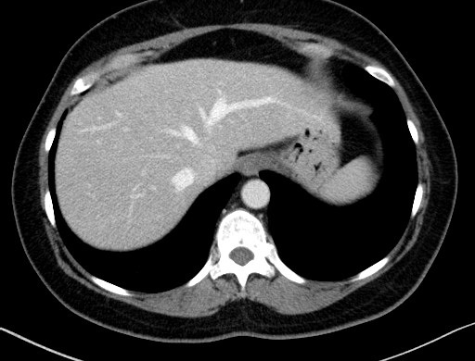
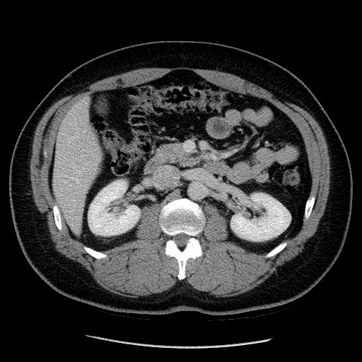
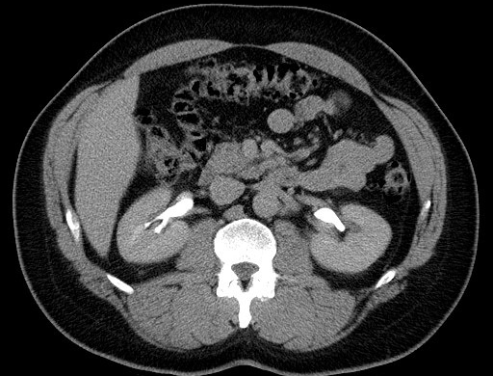
Protocol Abdominal CT scans using fine-tuned LLM
Tailoring CT scan to the indication based on provided clinical information (clinic notes, order information, allergies, renal function)
Arterial phase (30 s)
Venous phase (60 s)
Oral contrast? IV contrast?
Pre and post IV contrast images?
Timing or “phase” of imaging – arterial, portal venous, delays?
Special circumstances – rectal contrast? CT cystogram?
Contraindications to IV contrast
(renal insufficiency = cr>2.0 mg/dL, severe allergy)
Nephrographic phase (90 s)
Excretory phase (7 min)

Slide 6
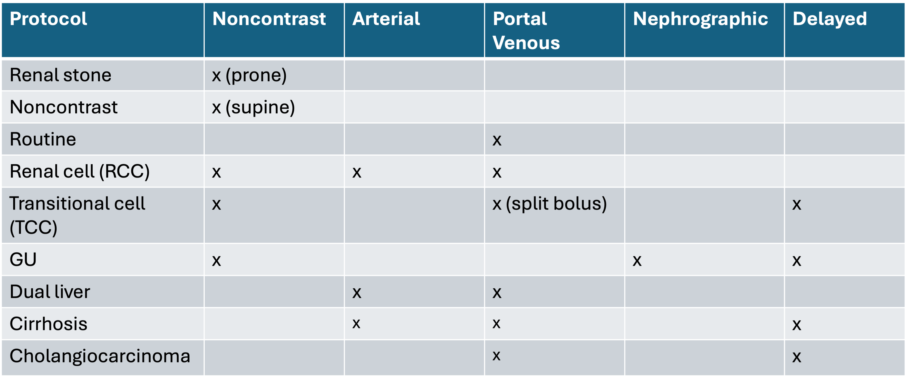
Protocol Abdominal CT scans using fine-tuned LLM
Tailoring CT scan to the indication based on provided clinical information (clinic notes, order information, allergies, renal function)
Subset of 20 protocols

Slide 7
Protocol Abdominal CT scans using fine-tuned LLM
Tasks :
Convert fine-tuned Mistral 7B Instruct model on Huggingface (>90% acc) to gguf and ultimately llamafile for local model API
Show feasibility of using on our clinical data, interface with EHR
Create dataset of difficult/edge cases for future refinement/testing of the model once deployed
Applicability and Impact:
Specific to Duke radiology protocols.
Save ~ 1-2 hr/day of an Abdominal Radiologists time, reduce interruptions
Publishable?

Slide 8
Protocol Abdominal CT scans using fine-tuned LLM
Timeline:
Convert fine-tuned Mistral 7B Instruct model on Huggingface (>90% acc) to gguf and ultimately llamafile for local model API (weeks 1 – assess feasibility, weeks 1-4 convert and initial testing)
Build backend using the local model AIPI (weeks 4-5)
Build front end (weeks 5-7)
Dockerize and deploy (weeks 7-8)
Create dataset of difficult/edge cases and testing (remainder)

Slide 9
Chatbot for Radiology Residents
Resource for our trainees from information from Dukerads.com website (protocols, who to call for procedures, departmental policies) as well as user manuals for our main software (Visage image viewer and Powerscribe dictation system).
Make use of RAG with LLM (Llama-3 8B Instruct locally)
User-friendly front end

Slide 10
Chatbot for Radiology Residents
Tasks :
Build RAG backend, incorporating open-source model (Llama-3 8B Instruct) as llamafile
Build front end, learning Flask in the process
Create database
Applicability and Impact:
Specific to Duke Radiologists, geared towards trainees but more generally useful within the Department
Timeline:
Database within next two weeks (Pinecone)
Build RAG using open-source model (weeks 2-4)
Build front-end using Flask (weeks 4-7)
Deployment and method of updating (remainder of time)

Slide 11
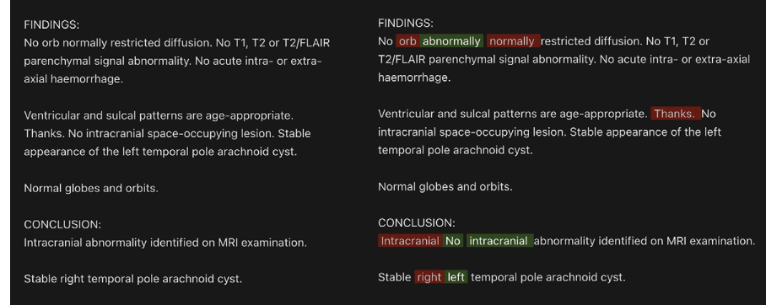
Error Checking Radiology Reports
Up to 20-50% of reports have some sort of speech recognition error, with estimated 2% with clinically significant errors (“new” versus “no”, omit “No”, “left/right”).
RA Schmidt, et. al., Radiology: Artificial Intelligence 2024; 6(2):e230205

Slide 12
Error Checking Radiology Reports
Checks dictated reports for errors, highlighted for acceptance/rejection of changes by the user
Local LLM (Llama-3 8B Instruct) to check reports for right/left errors, transcriptions errors leading to nonsense text, omission/addition/substitution of words
API that can be used by the local version of transcription software

Slide 13
Error Checking Radiology Reports
Tasks :
Open-source model (Llama-3 8B Instruct) as llamafile
Prompt engineering/COT to learn task
Front end
Applicability and Impact:
Could be generally useful in the majority of Radiology practices using Powerscribe if can incorporate
Timeline:
Model and code to call it (weeks 1-3)
Refine prompts to catch different types of errors, testing (weeks 2-5)
Build front-end (weeks 4-7)
Deployment and interface with Powerscribe (remainder of time)

Slide 14
Translating Medical Report for Improved Patient Understanding
Translates radiology report into terms 5th grader could understand
Local LLM (Llama-3 8B Instruct) to provide translation
API that can be used by the MyChart version of EHR

Slide 15
Translating Medical Report for Improved Patient Understanding
Tasks :
Open-source model (Llama-3 8B Instruct) as llamafile
Build front end
Applicability and Impact:
Could be generally useful to help patients
Crowded space with many other products
Timeline:
Build back end with the llamafile (weeks 1-3)
Build front-end (weeks 4-7)
Deployment and user-friendly interface (remainder of time)

Slide 16
Thank you
Week 0 Demo Video
Chad Miller

Slide 17
Protocol Abdominal CT scans using fine-tuned LLM
Without IV Contrast
Tailoring CT scan to the indication based on provided clinical information
Oral contrast? IV contrast?
Pre and post IV contrast images?
Timing or “phase” of imaging – arterial, portal venous, delays?
Special circumstances – rectal contrast? CT cystogram?
Contraindications to IV contrast
(renal insufficiency = cr>2.0 mg/dL, severe allergy)
With IV Contrast

Slide 18
Tailoring CT scan to the indication based on provided clinical information
Protocol Abdominal CT scans using fine-tuned LLM
Arterial phase (30 s)
Venous phase (60 s)
Oral contrast? IV contrast?
Pre and post IV contrast images?
Timing or “phase” of imaging – arterial, portal venous, delays?
Special circumstances – rectal contrast? CT cystogram?
Contraindications to IV contrast
(renal insufficiency = cr>2.0 mg/dL, severe allergy)
Nephrographic phase (90 s)
Excretory phase (7 min)

Slide 19
Tailoring CT scan to the indication based on provided clinical information (clinic notes, order information, allergies, renal function)
Protocol Abdominal CT scans using fine-tuned LLM
Subset of 20 protocols
Notes:
Example of renal lesion needing both with and without contrast

Slide 20
Tailoring CT scan to the indication based on provided clinical information
Protocol Abdominal CT scans using fine-tuned LLM
Tasks :
1. Convert model to gguf and ultimately llamafile for local model API
2. Show feasibility of using on our clinical data, interface with EHR
3. Create dataset of difficult/edge cases for future refinement/testing of the model once deployed
Applicability and Impact:
Specific to Duke radiology protocols.
Publishable?
Save ~ 1-2 hr/day of an Abdominal Radiologists time, reduce interruptions
Notes:
Example of renal lesion needing both with and without contrast

